Slide 1
SDLC MODELS
TATA TECHNOLOGIES

Slide 2
WATERFALL MODEL
Waterfall approach was first SDLC Model to be used widely in Software Engineering to ensure success of the project.
In "The Waterfall" approach, the whole process of software development is divided into separate phases.
In Waterfall model, typically, the outcome of one phase acts as the input for the next phase sequentially.

Slide 3
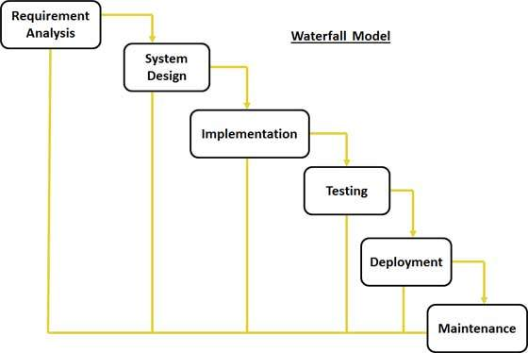
Diagrammatic Representation

Slide 4
Pros and Cons
Pros | Cons
Simple and easy to understand and use Easy to manage due to the rigidity of the model . each phase has specific deliverables and a review process. Phases are processed and completed one at a time. Works well for smaller projects where requirements are very well understood. Clearly defined stages. Well understood milestones. Easy to arrange tasks. Process and results are well documented. | No working software is produced until late during the life cycle. High amounts of risk and uncertainty. Not a good model for complex and object-oriented projects. Poor model for long and ongoing projects. Not suitable for the projects where requirements are at a moderate to high risk of changing. So risk and uncertainty is high with this process model. It is difficult to measure progress within stages. Cannot accommodate changing requirements. Adjusting scope during the life cycle can end a project. Integration is done as a "big-bang. at the very end, which doesn't allow identifying any technological or business bottleneck or challenges early.

Slide 5
ITERATIVE MODEL DESIGN
Iterative process starts with a simple implementation of a subset of the software requirements and iteratively enhances the evolving versions until the full system is implemented.
At each iteration, design modifications are made and new functional capabilities are added.
The basic idea behind this method is to develop a system through repeated cycles (iterative) and in smaller portions at a time (incremental).

Slide 6
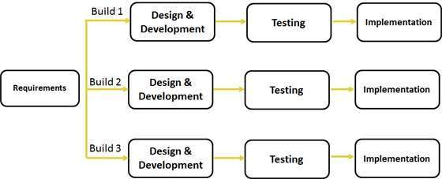
Diagrammatic Representation

Slide 7
Pros and Cons
Pros | Cons
Some working functionality can be developed quickly and early in the life cycle. Results are obtained early and periodically. Parallel development can be planned. Progress can be measured. Less costly to change the scope/requirements. Testing and debugging during smaller iteration is easy. Risks are identified and resolved during iteration; and each iteration is an easily managed milestone. Easier to manage risk - High risk part is done first. With every increment operational product is delivered. Issues, challenges & risks identified from each increment can be utilized/applied to the next increment. Risk analysis is better. It supports changing requirements. Initial Operating time is less. Better suited for large and mission-critical projects. During life cycle software is produced early which facilitates customer evaluation and feedback. | More resources may be required. Although cost of change is lesser but it is not very suitable for changing requirements. More management attention is required. System architecture or design issues may arise because not all requirements are gathered in the beginning of the entire life cycle. Defining increments may require definition of the complete system. Not suitable for smaller projects. Management complexity is more. End of project may not be known which is a risk. Highly skilled resources are required for risk analysis. Projects progress is highly dependent upon the risk analysis phase.

Slide 8
SPIRAL MODEL
The spiral model combines the idea of iterative development with the systematic, controlled aspects of the waterfall model.
Spiral model is a combination of iterative development process model and sequential linear development model i.e. waterfall model with very high emphasis on risk analysis.
It allows for incremental releases of the product, or incremental refinement through each iteration around the spiral.

Slide 9
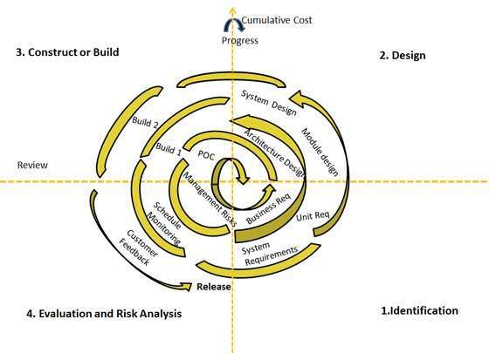
Diagrammatic Representation

Slide 10
Pros and Cons
Pros | Cons
Changing requirements can be accommodated. Allows for extensive use of prototypes Requirements can be captured more accurately. Users see the system early. Development can be divided into smaller parts and more risky parts can be developed earlier which helps better risk management. | Management is more complex. End of project may not be known early. Not suitable for small or low risk projects and could be expensive for small projects. Process is complex Spiral may go indefinitely. Large number of intermediate stages requires excessive documentation.

Slide 11
V-MODEL DESIGN
The V - model is SDLC model where execution of processes happens in a sequential manner in V-shape. It is also known as Verification and Validation model.
V - Model is an extension of the waterfall model and is based on association of a testing phase for each corresponding development stage.
This means that for every single phase in the development cycle there is a directly associated testing phase. This is a highly disciplined model and next phase starts only after completion of the previous phase.

Slide 12
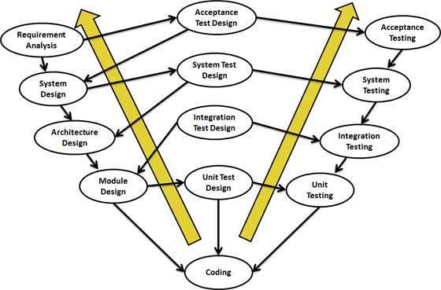
Diagrammatic Representation

Slide 13
Pros and Cons
Pros | Cons
This is a highly disciplined model and Phases are completed one at a time. Works well for smaller projects where requirements are very well understood. Simple and easy to understand and use. Easy to manage due to the rigidity of the model . each phase has specific deliverables and a review process. | High risk and uncertainty. Not a good model for complex and object-oriented projects. Poor model for long and ongoing projects. Not suitable for the projects where requirements are at a moderate to high risk of changing. Once an application is in the testing stage, it is difficult to go back and change a functionality No working software is produced until late during the life cycle.

Slide 14
AGILE MODEL DESIGN
Agile SDLC model is a combination of iterative and incremental process models with focus on process adaptability and customer satisfaction by rapid delivery of working software product.
Agile Methods break the product into small incremental builds. These builds are provided in iterations. Each iteration typically lasts from about one to three weeks. Every iteration involves cross functional teams working simultaneously on various areas like planning, requirements analysis, design, coding, unit testing, and acceptance testing.
At the end of the iteration a working product is displayed to the customer and important stakeholders.
bang model comprises of focusing all the possible resources in software development and coding, with very little or no planning.
The requirements are understood and implemented as they come. Any changes required may or may not need to revamp the complete software.
This model is ideal for small projects with one or two developers working together and is also useful for academic or practice projects.
Its an ideal model for the product where requirements are not well understood and the final release date is not given.

Slide 15
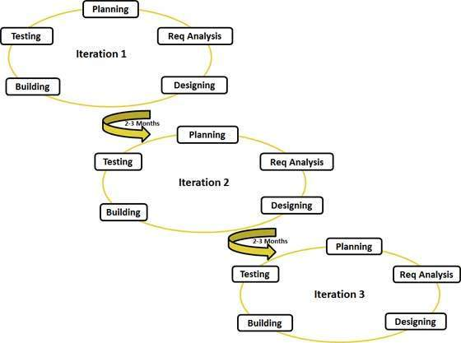
Diagrammatic Representation

Slide 16
Pros and Cons
Pros | Cons
Is a very realistic approach to software development Promotes teamwork and cross training. Functionality can be developed rapidly and demonstrated. Resource requirements are minimum. Suitable for fixed or changing requirements Delivers early partial working solutions. Good model for environments that change steadily. Minimal rules, documentation easily employed. Enables concurrent development and delivery within an overall planned context. Little or no planning required Easy to manage Gives flexibility to developers | Not suitable for handling complex dependencies. More risk of sustainability, maintainability and extensibility. An overall plan, an agile leader and agile PM practice is a must without which it will not work. Strict delivery management dictates the scope, functionality to be delivered, and adjustments to meet the deadlines. Depends heavily on customer interaction, so if customer is not clear, team can be driven in the wrong direction. There is very high individual dependency, since there is minimum documentation generated. Transfer of technology to new team members may be quite challenging due to lack of documentation.

Slide 17
RAPID APPLICATION DEVELOPMENT MODEL
The RAD (Rapid Application Development) model is based on prototyping and iterative development with no specific planning involved.
The process of writing the software itself involves the planning required for developing the product.
Rapid Application development focuses on gathering customer requirements through workshops or focus groups, early testing of the prototypes by the customer using iterative concept, reuse of the existing prototypes (components), continuous integration and rapid delivery.

Slide 18
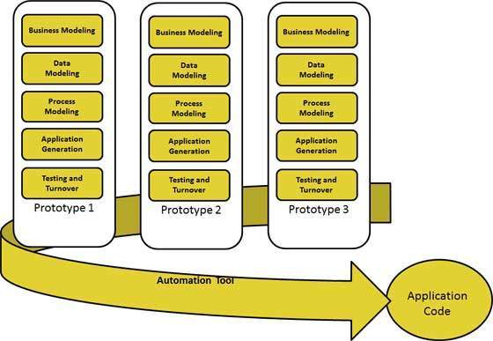
Diagrammatic Representation

Slide 19
Pros and Cons
Pros | Cons
Changing requirements can be accommodated. Progress can be measured. Iteration time can be short with use of powerful RAD tools. Productivity with fewer people in short time. Reduced development time. Increases reusability of components Quick initial reviews occur Encourages customer feedback Integration from very beginning solves a lot of integration issues. | Dependency on technically strong team members for identifying business requirements. Only system that can be modularized can be built using RAD. Requires highly skilled developers/designers. High dependency on modelling skills. Inapplicable to cheaper projects as cost of modelling and automated code generation is very high. Management complexity is more. Suitable for systems that are component based and scalable. Requires user involvement throughout the life cycle. Suitable for project requiring shorter development times.

Slide 20
THANK YOU

